Slide 1
Chapter 4
Dynamics of Drive Systems
4.1 Motion Pattern and Load Characteristics
4.2 Dynamic Equation
4.3 Inertia Referring of Multi-axle System.
4.4 Summary of Load Characteristics

Slide 2
4.1 Motion Pattern and Load Characteristics
4.1.1 Basic Idea of Electrical Machine Drive systems
Electrical machine drive system play an important role in modern industry .The reason is that：
a. Electric is easier to produced, transmit, and distribute.
b. Various motors can meet vast requirements of
manufacturing.
c. High efficiency 70-95%. But engine 30%.
d. Easy to control and operate.

Slide 3
4.1.1 Basic Idea of Electrical Machine Drive systems
Power
Transmission system
Manufacture mechanism
controller
motors
electrical machine drive system

Slide 4
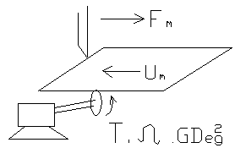
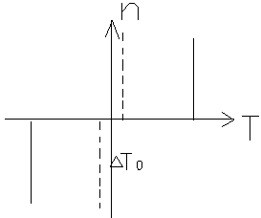
4.1 Motion Pattern and Load Characteristics
4.1.2 Typical Motion Patterns and Load Characteristics
1. Resistant torque load (反抗性转矩负载)
Resistant load
Torque – Speed curve
The constant torque load has the performance of the
friction(摩擦力)

Slide 5
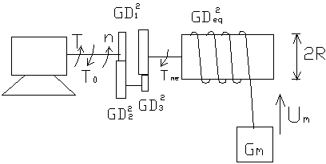
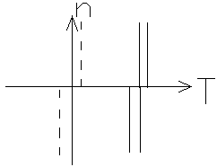
4.1.2 Typical Motion Patterns and Load Characteristics
2. Gravitational torque load
Because the direction of the gravity is always pointing to the centre of the earth, the gravitational load torque is at one side of the T-n plane.
Gravitational load
Torque – Speed curve

Slide 6
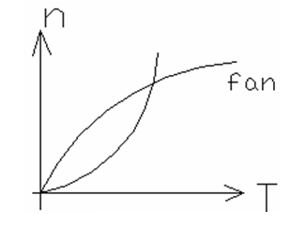
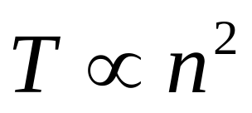
4.1.2 Typical Motion Patterns and Load Characteristics
3. Fan and pump load
Normally the fan load has the property of the torque that is proportional to the speed squared as shown below：
Torque – Speed curve

Slide 7
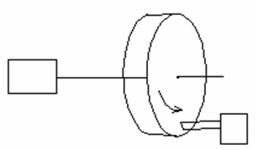
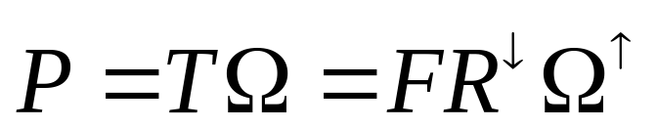
4.1.2 Typical Motion Patterns and Load Characteristics
4.Constant power load
Where F is the cutting force, and R is the cutting radius. It can be known that, if the power P is kept constant, when cutting force is un-change, then the regular speed will increase when radius becomes smaller, which is called constant power control. And the load with this kind of characteristic is considered as constant power load.
Constant power load

Slide 8
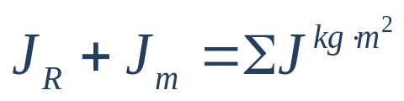
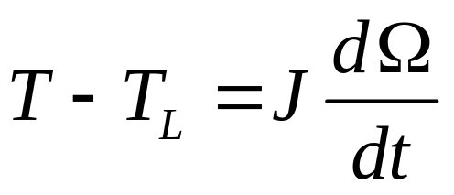
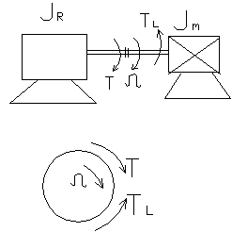



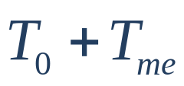

4.2 Dynamic Equation
4.2.1 Balance Equation of single axle drive system
If the total inertial of a system is , then,
the dynamic drive equation can be expressed as:
Where
T --- electromagnetic torque
--- friction (no- load ) torque
--- mechanical torque
--- load torque =
single axle drive system
--- angular speed, radians/s.

Slide 9
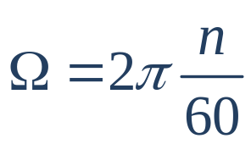
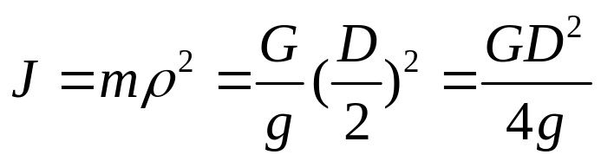

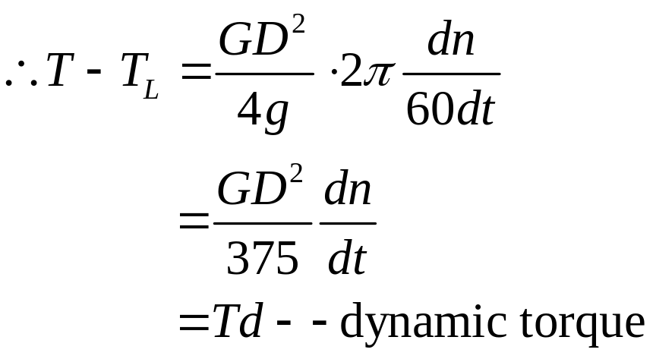



4.2.1 Balance Equation of single axle drive system
Sometimes, we use n to replace , Which is
where:
when:

Slide 10
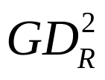
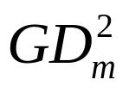
4.2 Dynamic Equation
4.2.2 Inertia of Drive System
Can be got from machine data sheet.
Can be obtained from Design department.

Slide 11
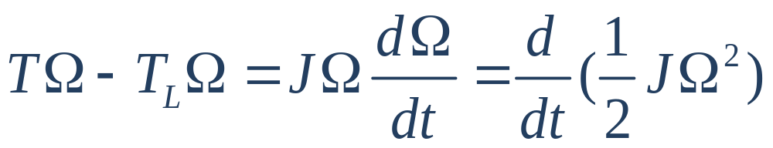


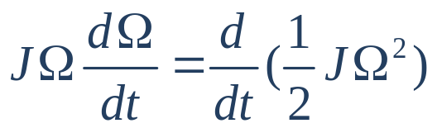
4.2.3 Power Balance Equation
is electromagnetic power
is mechanical power
is the change of dynamic energy
in the system

Slide 12
4.3 Inertia Referring of Multi-axle System
The referring principle from multi-axle to single-axle should
comply with the law of conversation of energy, i.e. to keep
mechanical power and dynamic energy unchanged before
and after the conversion.
load torque referring
--- the power should be kept at constant
inertia referring
--- the dynamic energy should be kept at constant

Slide 13
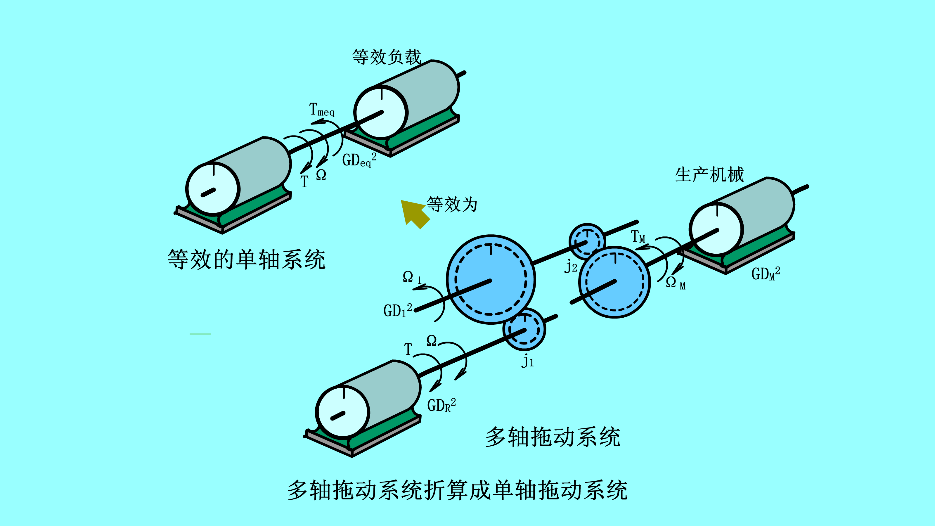
4.3.1 Rotating system
Look at the example shown below

Slide 14
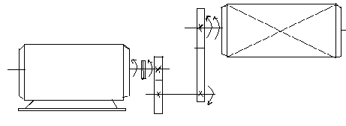
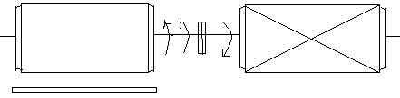
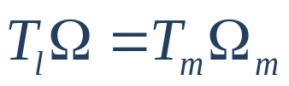
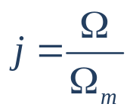
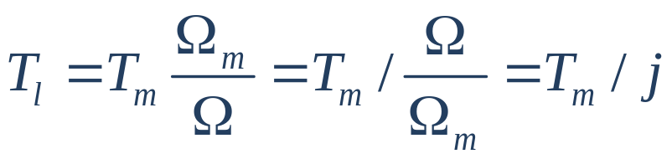
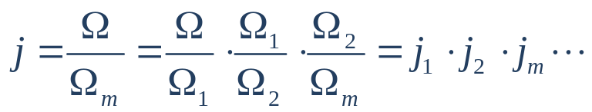
4.3.1 Rotating system
Load torque referring
--- the power should be kept at constant
mechanism
Torque equation
GD²_{eq}
GD²_{R}
T_{m}
j₂
GD²_{M}
Ｔ
Ｔ_{m e q}
T
GD²₁
where:
--- speed ratio

Slide 15
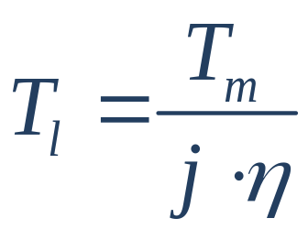

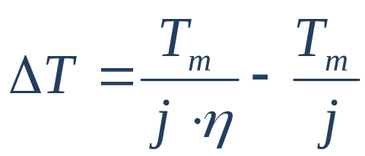
4.3.1 Rotating system
If consider the loss in mechanical system. Then
where :
--- transmission efficiency.
Torque loss:

Slide 16

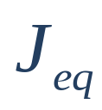
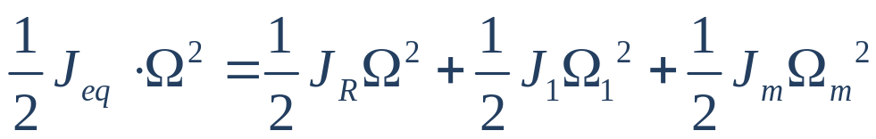
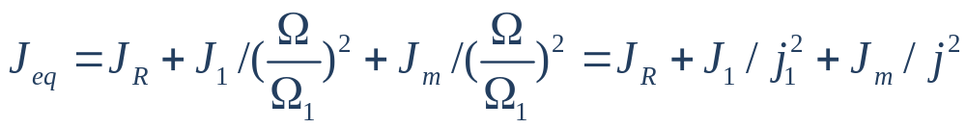

4.3.1 Rotating system
Referring of
--- the dynamic energy should be kept at constant
Assume is the equivalent inertial referred to motor shaft,
then:
where:

Slide 17
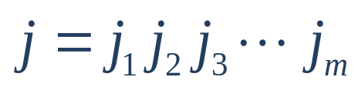
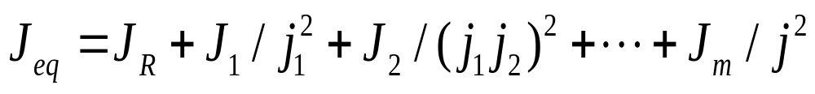
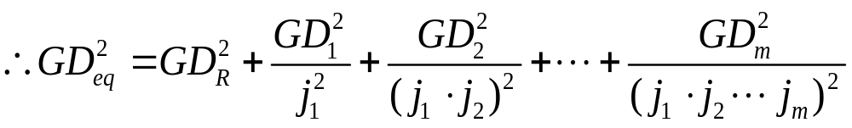
4.3.1 Rotating system
For the situation when transmission system has m+1 shafts,
,and hence:

Slide 18
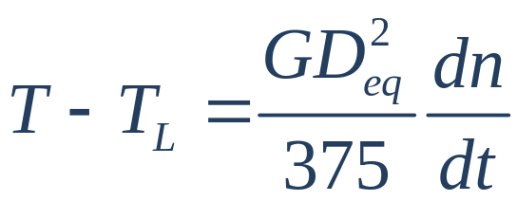
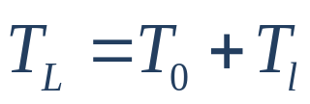


4.3.1 Rotating system
After referring:
where:
-- referred torque
-- motor no-load torque

Slide 19
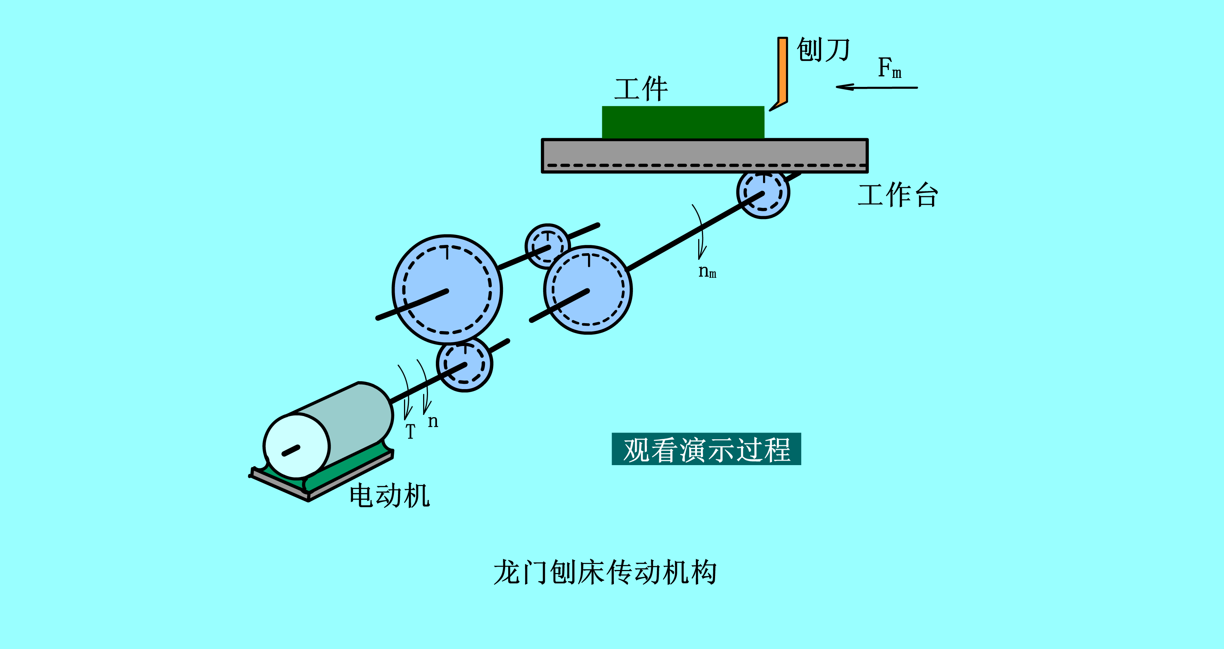
4.3 Inertia Referring of Multi-axle System
4.3.2 Level Motion Drive System

Slide 20

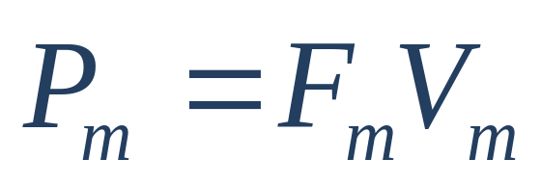
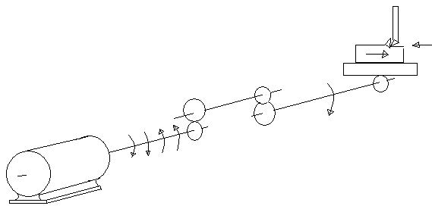



4.3.2 Level Motion Drive System
The cutting power on work piece is :
刨刀
工件
F_{m ，}
工作台
Where:
T _{e q}
n_{m}
n
-- cutting force
motor
-- Cutting speed

Slide 21
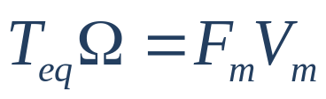
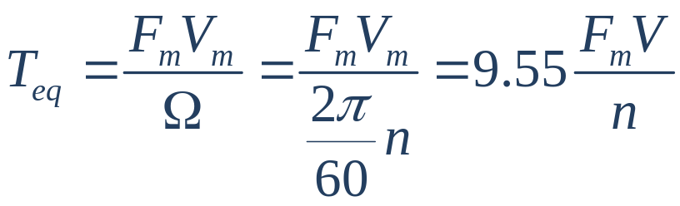
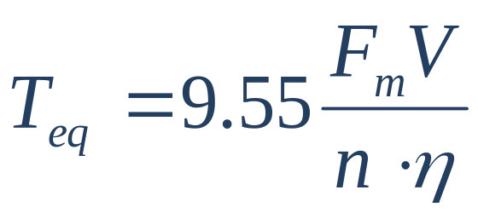
4.3.2 Level Motion Drive System
The cutting power referred to motor shaft will be
And the referred equivalent torque to motor shaft is
If consider the loss, then

Slide 22
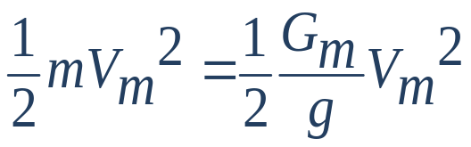
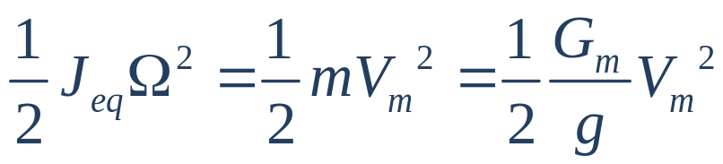
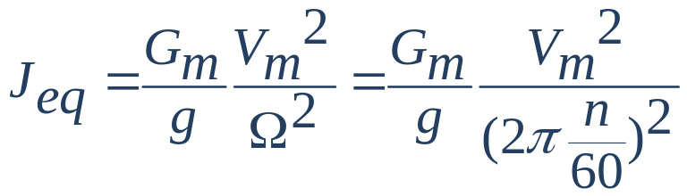
4.3.2 Level Motion Drive System
Referring of moment of inertial:
The principal is to keep the system dynamic energy unchanged
Compared with rotating system dynamic energy:
And

Slide 23
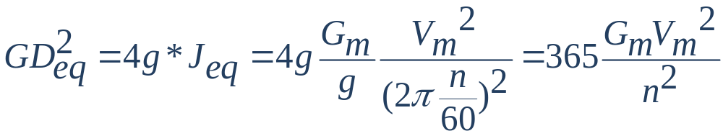


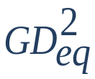

4.3.2 Level Motion Drive System
Therefore
where:
--- speed m/s
---
When considering rotating axles, add all together.

Slide 24
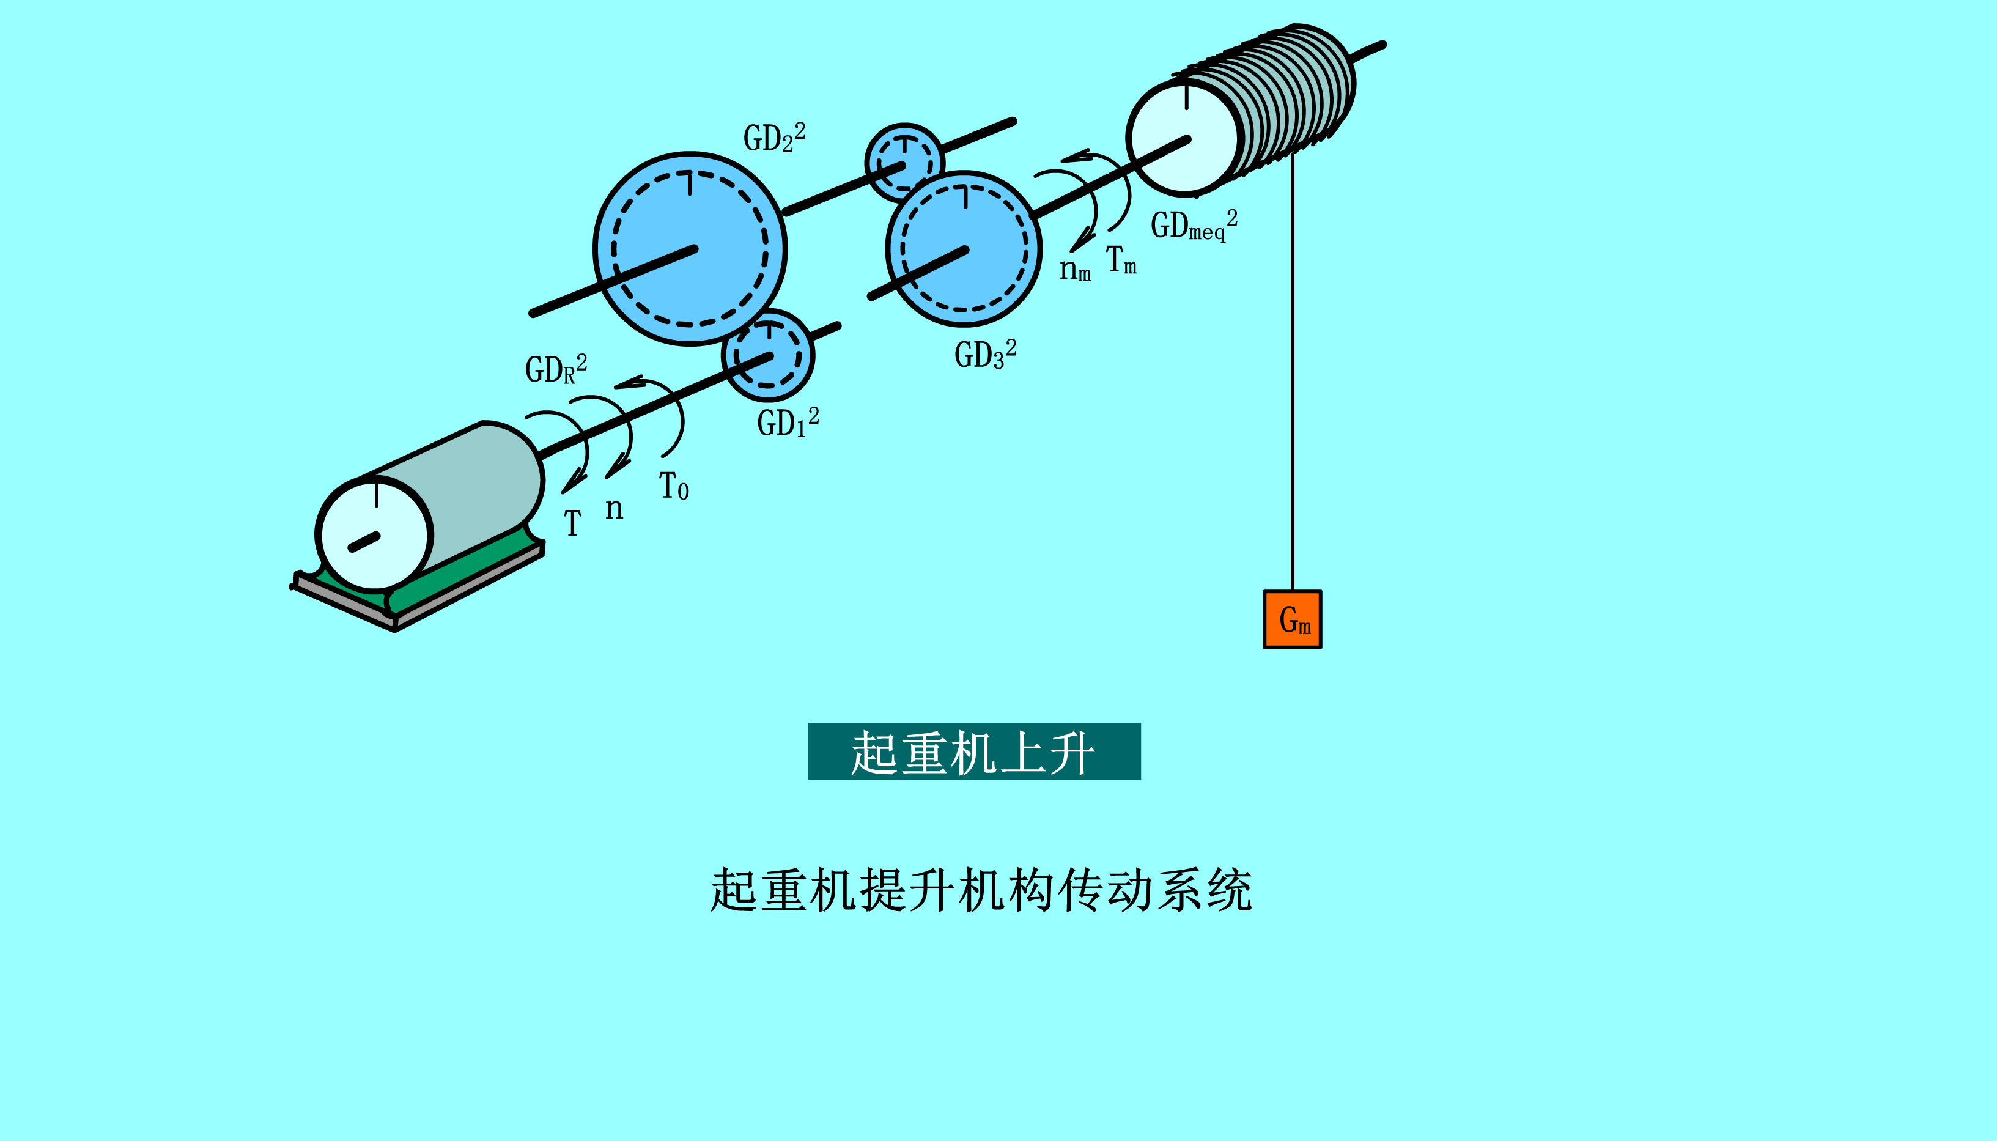
4.3 Inertia Referring of Multi-axle System
4.3.3 Referring of Vertical Moving System

Slide 25
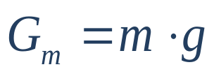

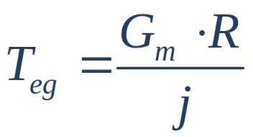

4.3 Inertia Referring of Multi-axle System
4.3.3 Referring of Vertical Moving System
Torque
Weight
When not considering loss
When considering loss:

Slide 26







4.3 Inertia Referring of Multi-axle System
Example 4 -1
P
=
20
KW
,
n
=
950
rpm
;
j
=
3
,
j
=
3
.
5
,
j
=
4
,
η
=
0
.
95
;
N
N
1
2
3
i
GD
2
=
123
N
.
m
2
,
GD
2
=
49
N
.
m
2
,
GD
2
=
40
N
.
m
2
,
GD
2
=
465
N
.
m
2
;
R
1
2
me
d
=
0
.
6
m
;
m
=
200
kg
,
m
=
5000
kg
;
T
=
0
.
0
0
Find out
(1)Load torque and speed on roller, torque on motor
shaft , and motor speed when
(2) to rotor shaft .
(3) when

Slide 27




4.3 Inertia Referring of Multi-axle System
Solution:
(1)
Example for Multi-axle drive

Slide 28





4.3 Inertia Referring of Multi-axle System
(2)
(3) When
motor torque:

Slide 29


4.4 Summary of Load Characteristics
4.4.1 Constant Torque Characteristics
Resistant load
Produced by friction force: such as tram, electrical vehicle,
and conveyor.
When
a. Resistant load b. Torque – Speed curve

Slide 30
4.4.1 Constant Torque Characteristics
Potential torque or Gravitational torque load
The examples of this kind of loads can be lift, hoist, and
tram on a down hill slope, etc.
a. Gravitational load b. Torque – Speed curve

Slide 31




4.4 Summary of Load Characteristics
4.4.3 Constant Torque Characteristics
At outer edge of the work piece.
(a) Load example
Inside circle
Constant torque
Constant power (variable torque)
(b) T – n curve

Slide 32

4.4 Summary of Load Characteristics
4.4.3 Constant Torque Characteristics
Example 4-2:
Known:
Calculate the equivalent torque and the moment of inertial referred to the motor shaft when the cage is lifting and lowering.

Slide 33




4.4 Summary of Load Characteristics
4.4.3 Constant Torque Characteristics
Solution:
When compartment lifts
Power at roller side =
Power at motor side =

Slide 34




4.4 Summary of Load Characteristics
4.4.3 Constant Torque Characteristics
Solution:
Dynamic Energy:
When the compartment goes down
opposite.

